Slide 1
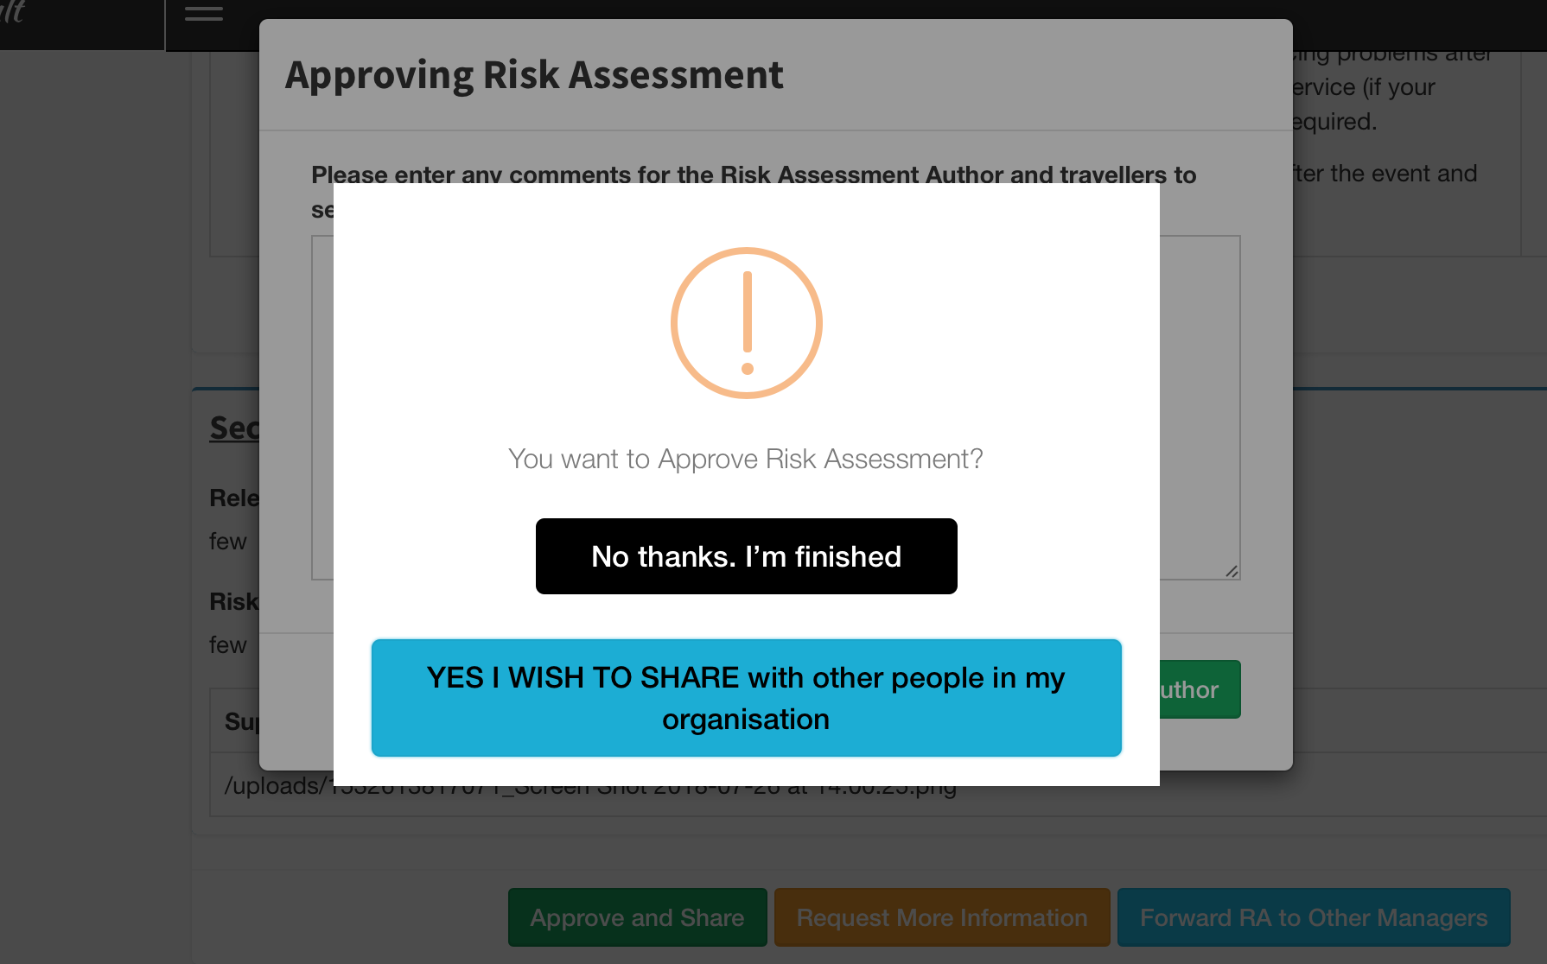
Approve Risk Assessment?
Approve & Complete
Approve & Share with Others
Cancel

